Slide 1



................................................Housing Project…………………..………………………….
Submitted by: Jyoti Chaudhary
Name of the project: Housing Project

Slide 2




ACKNOWLEDGMENT
These resources that helped me and guided me in completion of the project

Slide 3
Introduction
Business Problem Framing :
Houses are one of the necessary need of each and every person around the globe and therefore housing and real estate market is one of the markets which is one of the major contributors in the world’s economy. It is a very large market and there are various companies working in the domain. Data science comes as a very important tool to solve problems in the domain to help the companies increase their overall revenue, profits, improving their marketing strategies and focusing on changing trends in house sales and purchases.

Slide 4
Analytical Problem Framing
Statistical/ Analytical Modeling of the Problem:
We have used to describe our dataset
Code: #Train.describe()
and found many null values in the dataset.
#We have used correlation method to checking correlation and we have found this observation:
Code: # corr_mat = train.corr()
We can see that the features OverallQual, GarageArea and YearBuilt are closely correlated with the sale price.
That means these features play an important role in determining the SalePrice of a house. Similarly a lot of
inferences can be made just by looking at the heatmap but we're not going to go through each one of them.
If you don't know what a heatmap is and wish to learn.

Slide 5

Analytical Problem Framing
Data Exploration,Handle Missing values
Plot missing values
We have used for Analysing the dataset:
.Lineplot
.Distplot
Catplot
Define Evaluation Metric
def rmse(y, y_pred):
return np.sqrt(mean_squared_error(np.log(y), np.log(y_pred)))

Slide 6

Modelling:
……………….Ensemble Models………………
.from xgboost import XGBRegressor
.from lightgbm import LGBMRegressor

Slide 7
MODELLING:
.Model Stacking
Stacking (also called meta ensembling) is a model ensembling technique used to combine information from multiple predictive
models to generate a new model which usually performs better. In this project we use python package called vecstack that
helps us stack our models which we have imported earlier.
#Make predictions on the localized test set
-Save the model.

Slide 8

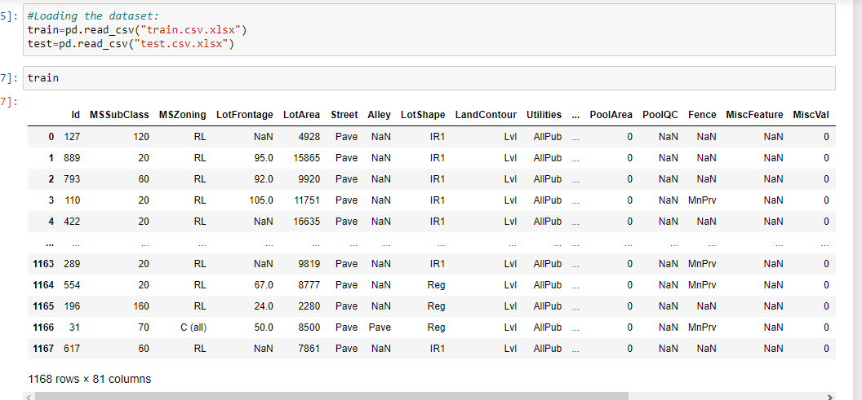
Data description

Slide 9
Description
• Data contains 1460 entries each having 81 variables.
Attributes: MSSubClass: Identifies the type of dwelling involved in the sale.
20 1-STORY 1946 & NEWER ALL STYLES
30 1-STORY 1945 & OLDER
40 1-STORY W/FINISHED ATTIC ALL AGES
45 1-1/2 STORY - UNFINISHED ALL AGES
50 1-1/2 STORY FINISHED ALL AGES
60 2-STORY 1946 & NEWER
70 2-STORY 1945 & OLDER
75 2-1/2 STORY ALL AGES
80 SPLIT OR MULTI-LEVEL
85 SPLIT FOYER
90 DUPLEX - ALL STYLES AND AGES
120 1-STORY PUD (Planned Unit Development) - 1946 & NEWER
150 1-1/2 STORY PUD - ALL AGES
160 2-STORY PUD - 1946 & NEWER
180 PUD - MULTILEVEL - INCL SPLIT LEV/FOYER
190 2 FAMILY CONVERSION - ALL STYLES AND AGES
MSZoning: Identifies the general zoning classification of the sale.
A Agriculture
C Commercial
FV Floating Village Residential
I Industrial
RH Residential High Density
RL Residential Low Density
RP Residential Low Density Park
RM Residential Medium Density

Slide 10
Attributes:
LotFrontage: Linear feet of street connected to property
LotArea: Lot size in square feet
Street: Type of road access to property
Grvl Gravel
Pave Paved
Alley: Type of alley access to property
Grvl Gravel
Pave Paved
NA No alley access
LotShape: General shape of property
Reg Regular
IR1 Slightly irregular
IR2 Moderately Irregular
IR3 Irregular
LandContour: Flatness of the property
Lvl Near Flat/Level
Bnk Banked - Quick and significant rise from street grade to building
HLS Hillside - Significant slope from side to side
Low Depression

Slide 11
Attributes
Utilities: Type of utilities available
AllPub All public Utilities (E,G,W,& S)
NoSewr Electricity, Gas, and Water (Septic Tank)
NoSeWa Electricity and Gas Only
ELO Electricity only
LotConfig: Lot configuration
Inside Inside lot
Corner Corner lot
CulDSac Cul-de-sac
FR2 Frontage on 2 sides of property
FR3 Frontage on 3 sides of property
LandSlope: Slope of property
Gtl Gentle slope
Mod Moderate Slope
Sev Severe Slope

Slide 12
Attributes:
Neighborhood: Physical locations within Ames city limits
Blmngtn Bloomington Heights
Blueste Bluestem
BrDale Briardale
BrkSide Brookside
ClearCr Clear Creek
CollgCr College Creek
Crawfor Crawford
Edwards Edwards
Gilbert Gilbert
IDOTRR Iowa DOT and Rail Road
MeadowV Meadow Village
Mitchel Mitchell
Names North Ames
NoRidge Northridge
NPkVill Northpark Villa
NridgHt Northridge Heights
NWAmes Northwest Ames
OldTown Old Town
SWISU South & West of Iowa State University
Sawyer Sawyer
SawyerW Sawyer West
Somerst Somerset
StoneBr Stone Brook
Timber Timberland
Veenker Veenker

Slide 13
Atrributes:
Condition1: Proximity to various conditions
Artery Adjacent to arterial street
Feedr Adjacent to feeder street
Norm Normal
RRNn Within 200' of North-South Railroad
RRAn Adjacent to North-South Railroad
PosN Near positive off-site feature--park, greenbelt, etc.
PosA Adjacent to postive off-site feature
RRNe Within 200' of East-West Railroad
RRAe Adjacent to East-West Railroad
Condition2: Proximity to various conditions (if more than one is present)
Artery Adjacent to arterial street
Feedr Adjacent to feeder street
Norm Normal
RRNn Within 200' of North-South Railroad
RRAn Adjacent to North-South Railroad
PosN Near positive off-site feature--park, greenbelt, etc.
PosA Adjacent to postive off-site feature
RRNe Within 200' of East-West Railroad
RRAe Adjacent to East-West Railroad

Slide 14
Attributes:
BldgType: Type of dwelling
1Fam Single-family Detached
2FmCon Two-family Conversion; originally built as one-family dwelling
Duplx Duplex
TwnhsE Townhouse End Unit
TwnhsI Townhouse Inside Unit
HouseStyle: Style of dwelling
1Story One story
1.5Fin One and one-half story: 2nd level finished
1.5Unf One and one-half story: 2nd level unfinished
2Story Two story
2.5Fin Two and one-half story: 2nd level finished
2.5Unf Two and one-half story: 2nd level unfinished
SFoyer Split Foyer
SLvl Split Level

Slide 15


Attributes:
OverallQual : Rates the overall material and finish of the house
10 Very Excellent
9 Excellent
8 Very Good
7 Good
6 Above Average
5 Average
4 Below Average
3 Fair
2 Poor
1 Very Poor
OverallCond : Rates the overall condition of the house
10 Very Excellent
9 Excellent
8 Very Good
7 Good
6 Above Average
5 Average
4 Below Average
3 Fair
2 Poor
1 Very Poor
YearBuilt : Original construction date

Slide 16
Attributes
YearRemodAdd : Remodel date (same as construction date if no remodeling or additions)
RoofStyle: Type of roof
Flat Flat
Gable Gable
Gambrel Gabrel (Barn)
Hip Hip
Mansard Mansard
Shed Shed
RoofMatl: Roof material
ClyTile Clay or Tile
CompShg Standard (Composite) Shingle
Membran Membrane
Metal Metal
Roll Roll
Tar&Grv Gravel & Tar
WdShake Wood Shakes
WdShngl Wood Shingles

Slide 17
ATTRIBUTES:
MasVnrType: Masonry veneer type
BrkCmn Brick Common
BrkFace Brick Face
CBlock Cinder Block
None None
Stone Stone
MasVnrArea: Masonry veneer area in square feet
ExterQual: Evaluates the quality of the material on the exterior
Ex Excellent
Gd Good
TA Average/Typical
Fa Fair
Po Poor
ExterCond: Evaluates the present condition of the material on the exterior
Ex Excellent
Gd Good
TA Average/Typical
Fa Fair
Po Poor

Slide 18
Attributes:
Foundation: Type of foundation
BrkTil Brick & Tile
CBlock Cinder Block
PConc Poured Contrete
Slab Slab
Stone Stone
Wood Wood
BsmtQual: Evaluates the height of the basement
Ex Excellent (100+ inches)
Gd Good (90-99 inches)
TA Typical (80-89 inches)
Fa Fair (70-79 inches)
Po Poor (<70 inches
NA No Basement
BsmtCond: Evaluates the general condition of the basement
Ex Excellent
Gd Good
TA Typical - slight dampness allowed
Fa Fair - dampness or some cracking or settling
Po Poor - Severe cracking, settling, or wetness
NA No Basement

Slide 19

Attributes:
BsmtExposure: Refers to walkout or garden level walls
Gd Good Exposure
Av Average Exposure (split levels or foyers typically score average or above)
Mn Mimimum Exposure
No No Exposure
NA No Basement
BsmtFinType1: Rating of basement finished area
GLQ Good Living Quarters
ALQ Average Living Quarters
BLQ Below Average Living Quarters
Rec Average Rec Room
LwQ Low Quality
Unf Unfinshed
NA No Basement
BsmtFinSF1: Type 1 finished square feet
BsmtFinType2: Rating of basement finished area (if multiple types)
GLQ Good Living Quarters
ALQ Average Living Quarters
BLQ Below Average Living Quarters
Rec Average Rec Room
LwQ Low Quality
Unf Unfinshed
NA No Basement
BsmtFinSF2: Type 2 finished square feet
BsmtUnfSF: Unfinished square feet of basement area
TotalBsmtSF: Total square feet of basement area

Slide 20
Attributes:
Heating: Type of heating
Floor Floor Furnace
GasA Gas forced warm air furnace
GasW Gas hot water or steam heat
Grav Gravity furnace
OthW Hot water or steam heat other than gas
Wall Wall furnace
HeatingQC: Heating quality and condition
Ex Excellent
Gd Good
TA Average/Typical
Fa Fair
Po Poor
CentralAir: Central air conditioning
N No
Y Yes
Electrical: Electrical system
SBrkr Standard Circuit Breakers & Romex
FuseA Fuse Box over 60 AMP and all Romex wiring (Average)
FuseF 60 AMP Fuse Box and mostly Romex wiring (Fair)
FuseP 60 AMP Fuse Box and mostly knob & tube wiring (poor)
Mix Mixed

Slide 21

Attributes:
1stFlrSF: First Floor square feet
2ndFlrSF: Second floor square feet
LowQualFinSF: Low quality finished square feet (all floors)
GrLivArea: Above grade (ground) living area square feet
BsmtFullBath: Basement full bathrooms
BsmtHalfBath: Basement half bathrooms
FullBath: Full bathrooms above grade
HalfBath: Half baths above grade
Bedroom: Bedrooms above grade (does NOT include basement bedrooms)
Kitchen: Kitchens above grade

Slide 22
Attributes:
KitchenQual : Kitchen quality
Ex Excellent
Gd Good
TA Typical/Average
Fa Fair
Po Poor
TotRmsAbvGrd : Total rooms above grade (does not include bathrooms)
Functional : Home functionality (Assume typical unless deductions are warranted)
Typ Typical Functionality
Min1 Minor Deductions 1
Min2 Minor Deductions 2
Mod Moderate Deductions
Maj1 Major Deductions 1
Maj2 Major Deductions 2
Sev Severely Damaged
Sal Salvage only

Slide 23
Attributes:
Fireplaces: Number of fireplaces
FireplaceQu: Fireplace quality
Ex Excellent - Exceptional Masonry Fireplace
Gd Good - Masonry Fireplace in main level
TA Average - Prefabricated Fireplace in main living area or Masonry Fireplace in basement
Fa Fair - Prefabricated Fireplace in basement
Po Poor - Ben Franklin Stove
NA No Fireplace
GarageType: Garage location
2Types More than one type of garage
Attchd Attached to home
Basment Basement Garage
BuiltIn Built-In (Garage part of house - typically has room above garage)
CarPort Car Port
Detchd Detached from home
NA No Garage
GarageYrBlt: Year garage was built
GarageFinish: Interior finish of the garage
Fin Finished
RFn Rough Finished
Unf Unfinished
NA No Garage

Slide 24
Atrributes:
GarageCars: Size of garage in car capacity
GarageArea: Size of garage in square feet
GarageQual: Garage quality
Ex Excellent
Gd Good
TA Typical/Average
Fa Fair
Po Poor
NA No Garage
GarageCond: Garage condition
Ex Excellent
Gd Good
TA Typical/Average
Fa Fair
Po Poor
NA No Garage

Slide 25
Attributes:
PavedDrive: Paved driveway
Y Paved
P Partial Pavement
N Dirt/Gravel
WoodDeckSF: Wood deck area in square feet
OpenPorchSF: Open porch area in square feet
EnclosedPorch: Enclosed porch area in square feet
3SsnPorch: Three season porch area in square feet
ScreenPorch: Screen porch area in square feet
PoolArea: Pool area in square feet
PoolQC: Pool quality
Ex Excellent
Gd Good
TA Average/Typical
Fa Fair
NA No Pool
Fence: Fence quality
GdPrv Good Privacy
MnPrv Minimum Privacy
GdWo Good Wood
MnWw Minimum Wood/Wire
NA No Fence

Slide 26
Attributes:
MiscFeature: Miscellaneous feature not covered in other categories
Elev Elevator
Gar2 2nd Garage (if not described in garage section)
Othr Other
Shed Shed (over 100 SF)
TenC Tennis Court
NA None
MiscVal: $Value of miscellaneous feature
MoSold: Month Sold (MM)
YrSold: Year Sold (YYYY)
SaleType: Type of sale
WD Warranty Deed - Conventional
CWD Warranty Deed - Cash
VWD Warranty Deed - VA Loan
New Home just constructed and sold
COD Court Officer Deed/Estate
Con Contract 15% Down payment regular terms
ConLw Contract Low Down payment and low interest
ConLI Contract Low Interest
ConLD Contract Low Down
Oth Other

Slide 27
Attributes:
SaleCondition: Condition of sale
Normal Normal Sale
Abnorml Abnormal Sale - trade, foreclosure, short sale
AdjLand Adjoining Land Purchase
Alloca Allocation - two linked properties with separate deeds, typically condo with a garage unit
Family Sale between family members
Partial Home was not completed when last assessed (associated with New Homes)0000000000000000000000

Slide 28

Data Preprocessing Done:
X = train.drop('SalePrice', axis=1)
y = np.ravel(np.array(train[['SalePrice']]))
print(y.shape)
# Use train_test_split from sci-kit learn to segment our data into train and a local testset
X_train, X_test, y_train, y_test = train_test_split(X, y, test_size=0.2)

Slide 29
Tools Used:
I have installed xgboost, lightgbm, vecstack
For modelling we installed pakages then after import xgbooster
-> pip install xgboost
CODE : from xgboost import xgbooster
For modelling we installed pakages then after import LGBMRegressor
->pip install lightgbm
CODE: from lightgbm import LGBMRegressor
For plotting missing values.
-> pip install missingno
Import numpy as np # linear algebra
For Loading the dataset:
import pandas as pd # data processing, CSV file I/O (e.g. pd.read_csv)
pd.set_option('display.width', 1000)
# Plotting Tools
With matplotlib.pyplot(Plot missing values by count ),Plotting the figures.
import matplotlib.pyplot as plt
plt.style.use('ggplot')
import seaborn as sns

Slide 30
……… statistical and analytical approaches for solving of this problem.
…………………………………….
train.head()
train.dtypes()
train.shape()
train.info()
train.describe()
# find columns having missing values and count
search for missing data
Fixing the missing data
IMPUTING MISSING VALUES
Function to visualize missing values
Check null values in the dataframe
Checking Correlation
Visulaizing the relationship between SalePrice and YearBuilt
Lineplot
Visualizing the relationship between Sale prices and Overall Quality
.Lineplot
Visulizing the Distribution of SalePrice
Distplot
Visualizing the relationship between SalePrice and SaleType
Catplot

Slide 31
. Listing down all the algorithms used for the training and testing.
from sklearn.model_selection import train_test_split
Use train_test_split from sci-kit learn to segment our data into train and a local testset
X_train, X_test, y_train, y_test = train_test_split(X, y, test_size=0.2)

Slide 32
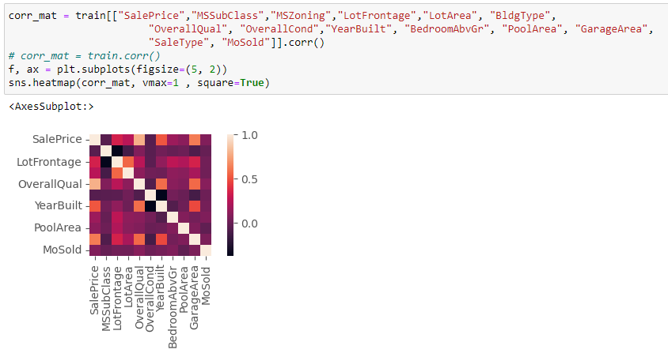
Visualization - -> Correlation:
We can see that the features OverallQual, GarageArea and YearBuilt are closely correlated with the sale price.
That means these features play an important role in determining the SalePrice of a house. Similarly a lot of
inferences can be made just by looking at the heatmap but we're not going to go through each one of them.
If you don't know what a heatmap is and wish to learn.

Slide 33
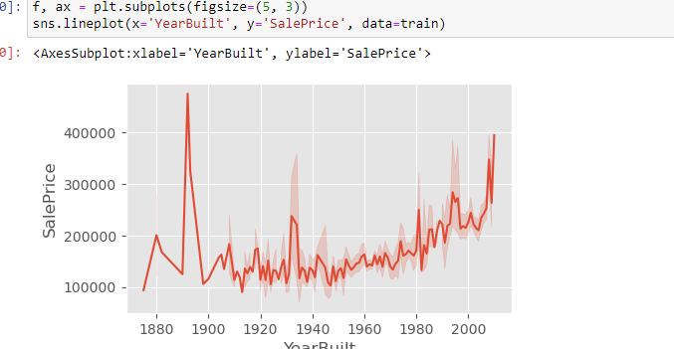

VISUALIZATION : Lineplot:
You might have noticed a significant increase in SalePrices just after the start of the 21st century,
which is pretty interesting. What's even more surprising is the late 1800s saw phenomenal increase in
SalePrices but dropping way below even before the end of that century.

Slide 34
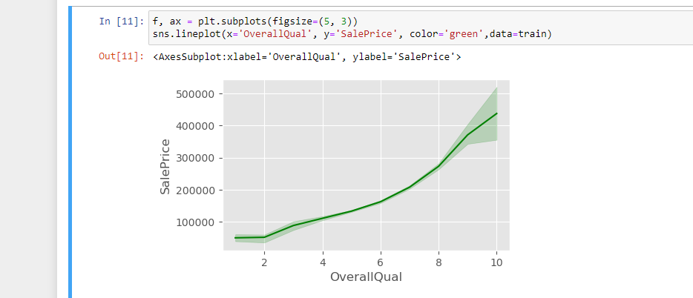

VISUALIZATION : Lineplot:
We can see that the SalePrices increase rapidly with houses with better overall quality which is pretty reasonable.

Slide 35
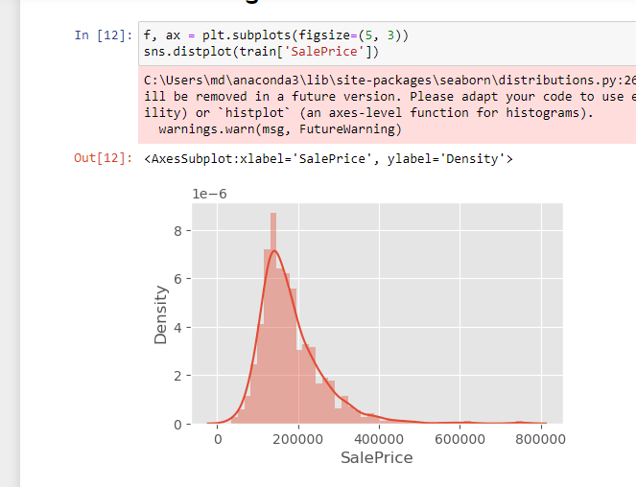

visualization Distplot:
It is clear that the selling prices for Sale types 2 and 6 are significantly higher than the others.

Slide 36
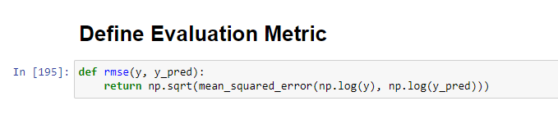
Code:Evaluation Metric

Slide 37
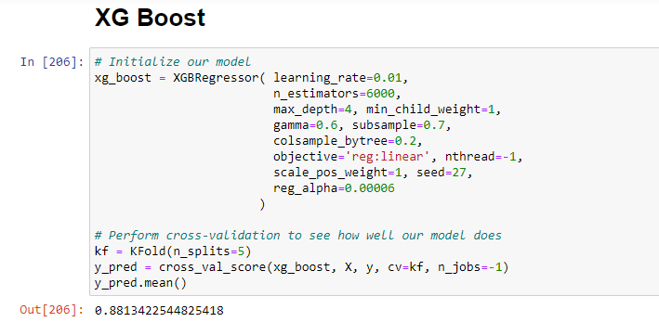
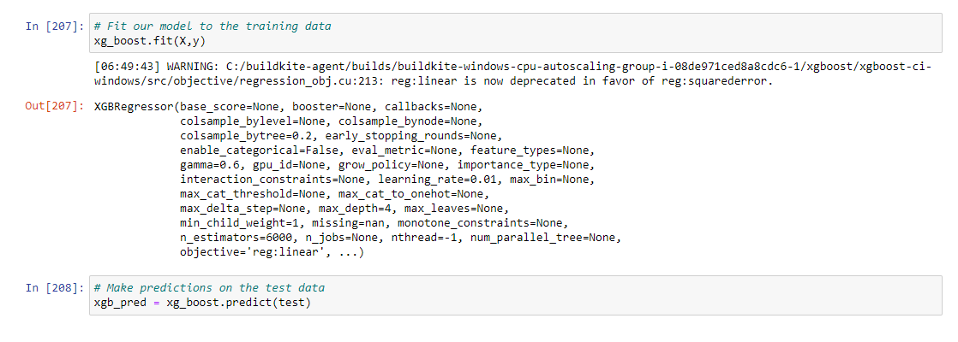
XG Boost:
We'll start by building standalone models, validating their performances.
Later we will stack all our models into an ensemble for better accuracy.

Slide 38
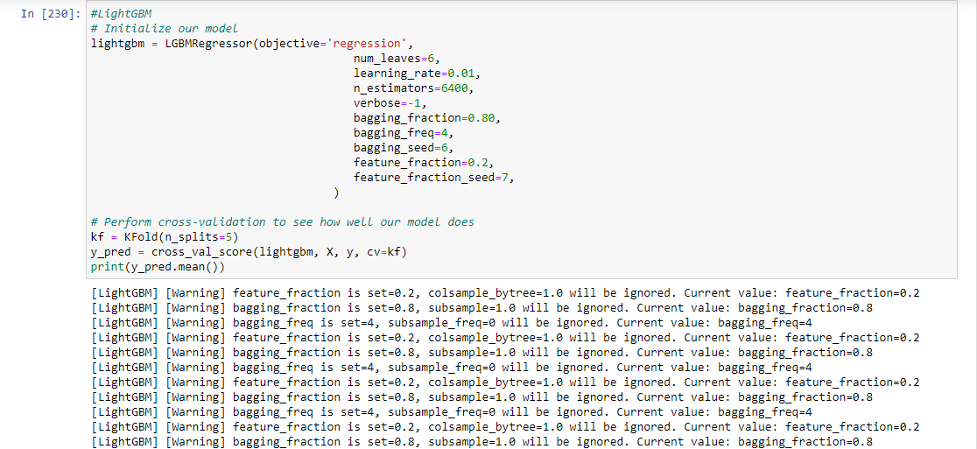
LightGBM:

Slide 39
CODE:# Fit our model to the training data. lightgbm.fit(X,y)
→OUTPUT=[LightGBM] [Warning] feature_fraction is set=0.2, colsample_bytree=1.0 will be ignored. Current value: feature_fraction=0.2 [LightGBM] [Warning] bagging_fraction is set=0.8, subsample=1.0 will be ignored. Current value: bagging_fraction=0.8 [LightGBM] [Warning] bagging_freq is set=4, subsample_freq=0 will be ignored. Current value: bagging_freq=4
Out[231]:
LGBMRegressor(bagging_fraction=0.8, bagging_freq=4, bagging_seed=6, feature_fraction=0.2, feature_fraction_seed=7, learning_rate=0.01, n_estimators=6400, num_leaves=6, objective='regression', verbose=-1)

Slide 40

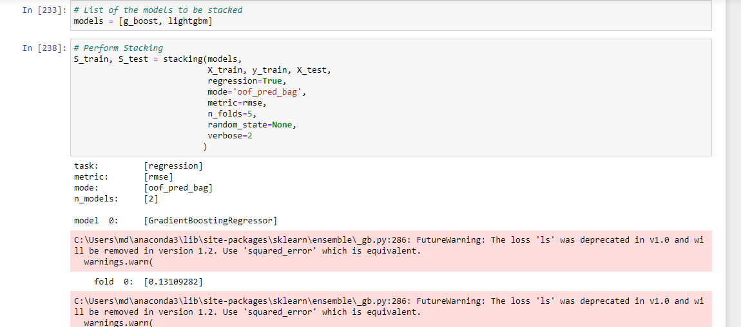
LIST OF THE MODELS TO BE STACKED:

Slide 41
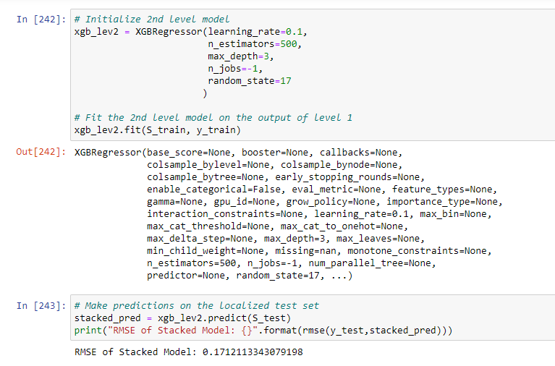
Intialize 2nd level model:

Slide 42
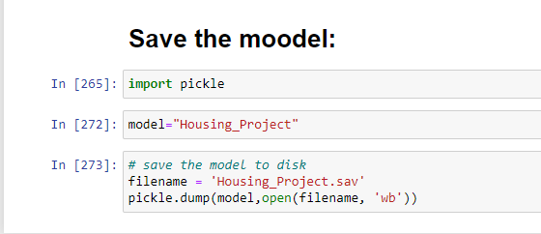
Save the model:

Slide 43
Conclusion of all the visualizations:
Correlation conclusion-We can see that the features OverallQual, GarageArea and YearBuilt are closely correlated with the sale price.
That means these features play an important role in determining the SalePrice of a house. Similarly a lot of
inferences can be made just by looking at the heatmap but we're not going to go through each one of them.
If you don't know what a heatmap is and wish to learn.

Slide 44
Conclusion of all the visualization :
Lineplot1
Lineplot2
You might have noticed a significant increase in SalePrices just after the start of the 21st century,
which is pretty interesting. What's even more surprising is the late 1800s saw phenomenal increase in
SalePrices but dropping way below even before the end of that century.
We can see that the SalePrices increase rapidly with houses with better overall quality which is pretty reasonable.

Slide 45
Conclusion
Distplot
Distplot:
It's clear that most of the houses, about 80% are sold for a price in the region on 100,000 and 200,000 dollars. Looks like there are a lot of houses sold in the mid 100,000s which makes up most of the data.
End of the project……………………………………………….
It is clear that the selling prices for Sale types 2 and 6 are significantly higher than the others.

